Slide 1
Assignment 01 Web Canvas
Software Studio 軟體設計與實驗
Hung-Kuo Chu
Department of Computer Science
National Tsing Hua University
CS2410

Slide 2
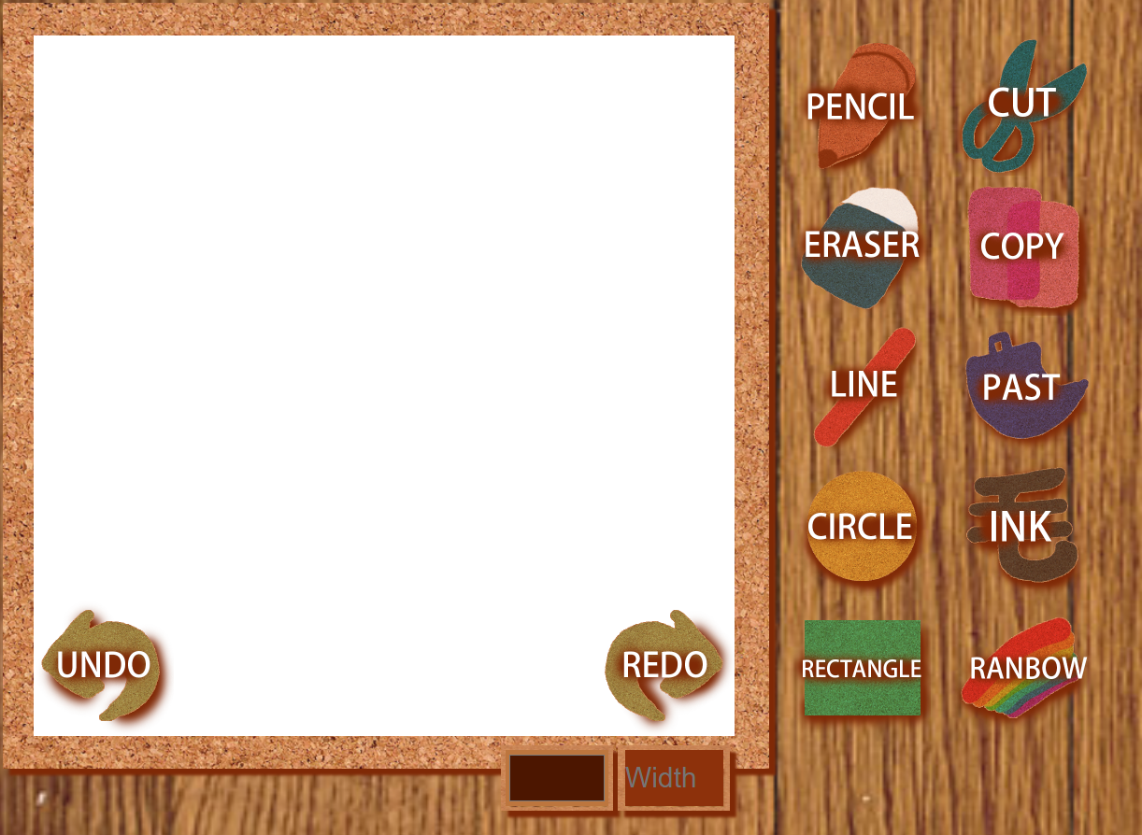
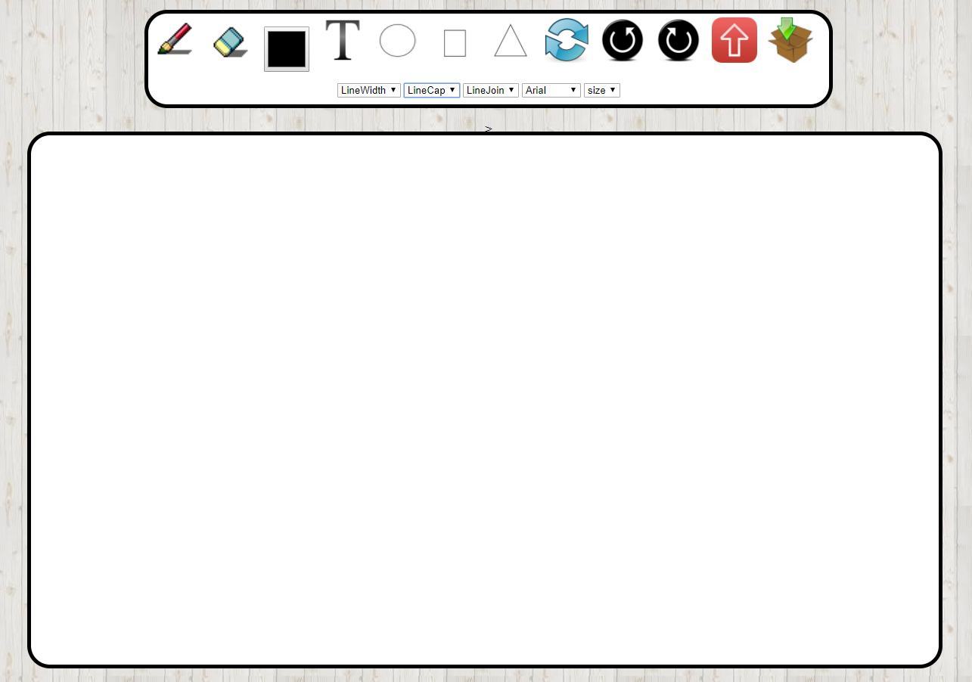
Web Canvas

Slide 3
Goal
Create your own gitlab project and name it as AS_01_WebCanvas
Create your own web page with HTML5 canvas element where we can draw somethings.(HTML)
Beautify appearance (CSS).
Design user interaction widgets and control tools for custom setting or editing (JavaScript).
Describing the functions of your canvas in README.md by HackMD (you can reference the template by TAs)
You ought to explain how to operate your web, if TAs can’t find the function, you won’t get the points.

Slide 4
Basic components
Basic control tools (30%)
Brush and eraser (You can not use white color as eraser!)
Color selector
Simple menu (brush size)
Text input (10%)
User can type texts on canvas
Font menu (typeface and size)
Cursor icon (10%)
The image should change according to the currently used tool
Refresh button (10%)
Reset canvas

Slide 5
Advanced tools
Different brush shapes (15%)
Circle, rectangle and triangle (5% for each shape)
Drag the cursor to make circles, rectangles, and triangles of different size (Please refer to the example)
Flickering canvas is not acceptable
Un/Re-do button (10%)
Image tool (5%)
User can upload image and paste it
Download (5%)
Download current canvas as an image file

Slide 6
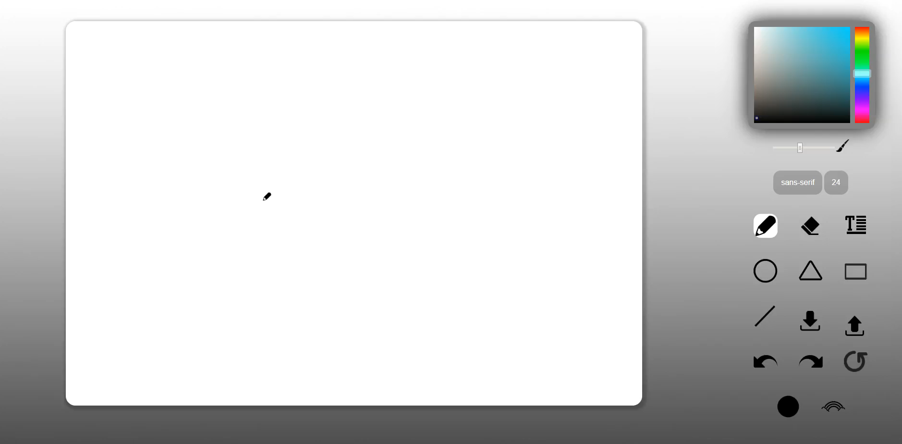
Basic Control Tools

Slide 7
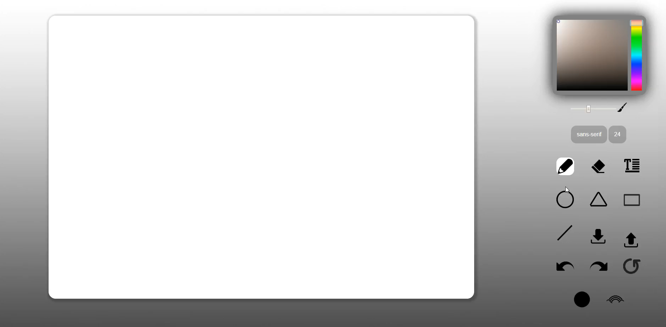
Text Input

Slide 8

Cursor Icon

Slide 9
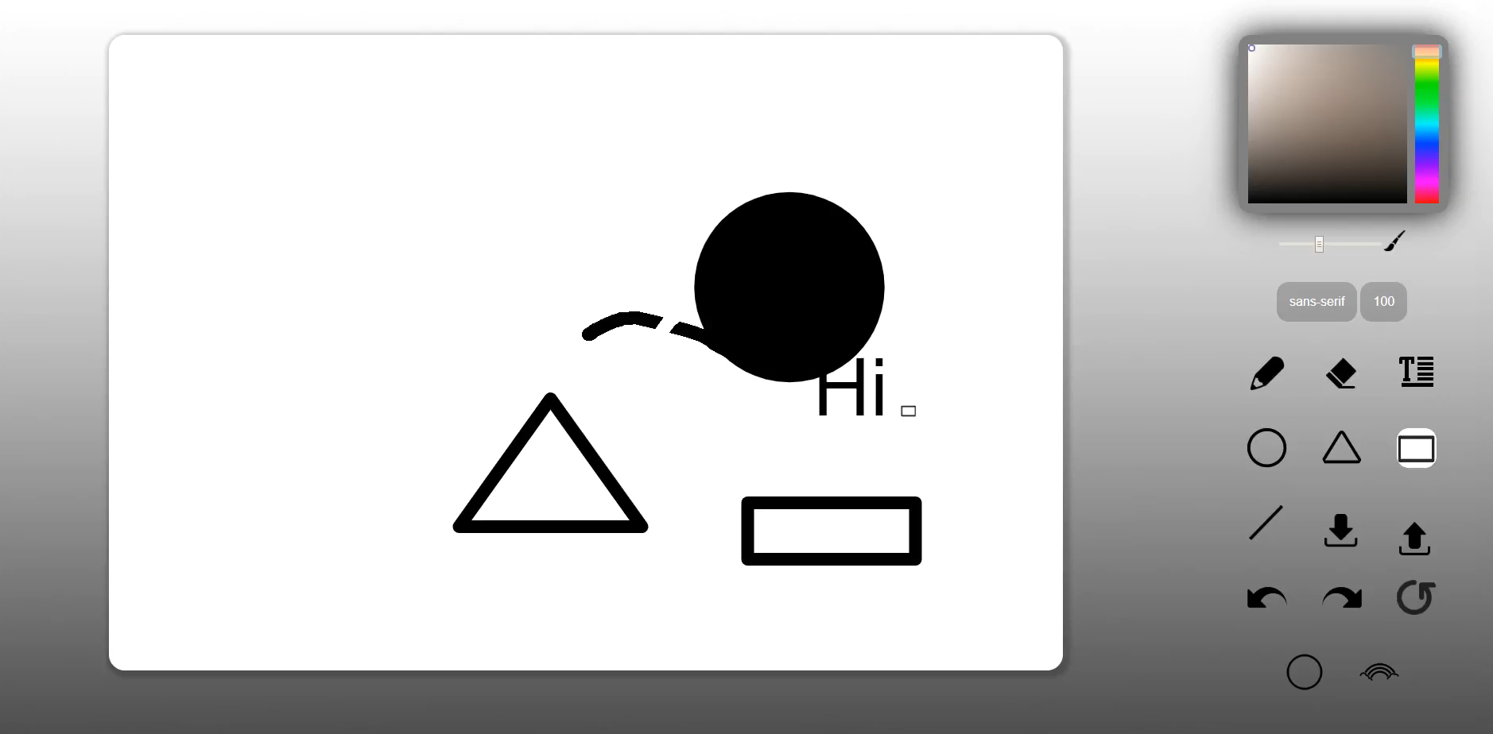
Refresh Button

Slide 10
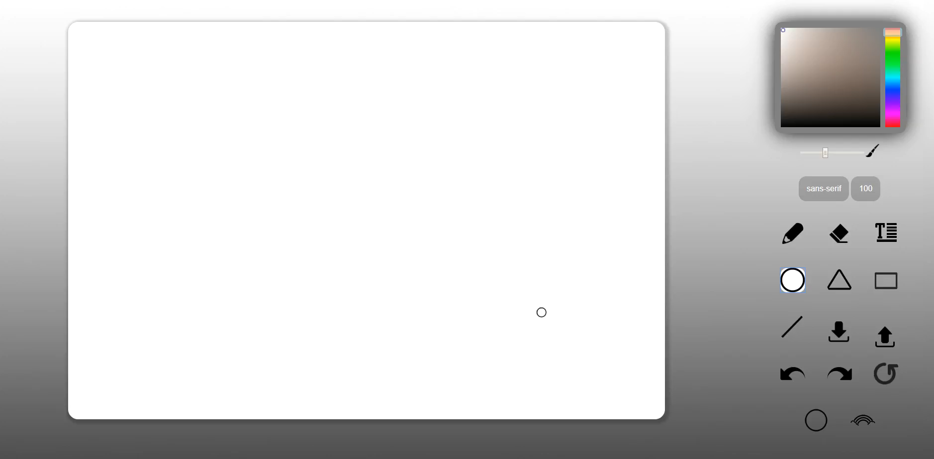
Different Brush Shape

Slide 11

Un/Re-do button

Slide 12

Image Tool

Slide 13

Download

Slide 14
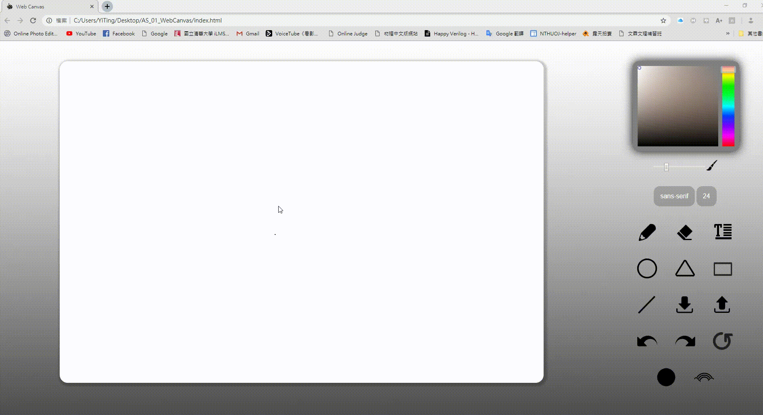
All Functions

Slide 15
Scoring
Item | Score
Basic components | 60%
Advance tools | 35%
Appearance (subjective) | 5%
Other useful widgets (describe on README.md) | 1~5%

Slide 16
Reminder
Deploy your web page to Gitlab page, including README.md, and ensure it works correctly.
Your main page should be named as “index.html”
URL should be : https://[studentID].gitlab.io/AS_01_WebCanvas
Upload all source code to FTP. (reference iLMS)
Compress all files into Assignment01_學號.zip then upload
index.html, .css, .js, README.md, etc.
source files
FIRM deadline: 2020/04/16 23:59 (commit time)
You will be graded ZERO under one of the following conditions
Missing the deadline, no matter what kind of reasons you have…
Plagiarism (抄襲), both the plagiarist (抄襲者) and accomplice (被抄襲者) will be graded zero.
Crashed program (e.g., 404 - Not Found)
Not upload the source files to FTP

